Slide 1
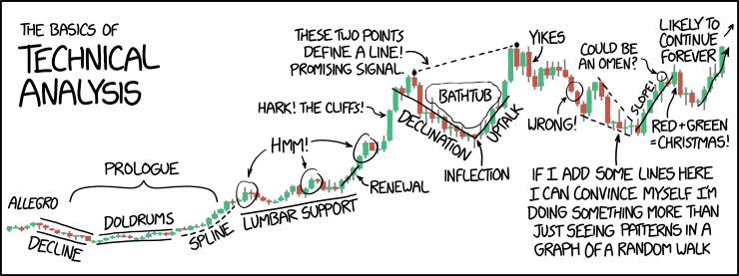
Error, Accuracy, Uncertainty and Validation
https://xkcd.com/2101/
D.E. Beaudette, Skye Wills, Zamir Libohova, Stephen Roecker
Notes:
TODO:
add Z's latest papers / posters on the topic of errors
SOC stock calculation

Slide 2
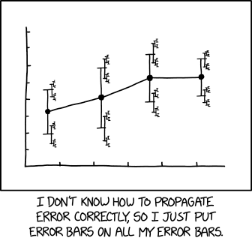
Outline
Definitions
Bias—Variance Compromise
Accuracy / Validation
Uncertainty
https://xkcd.com/2110/

Slide 3
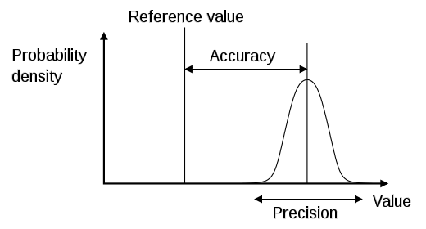
Precision vs. Accuracy vs. Uncertainty
Measurements (Errors)
Precision: The ability of a measurement to be consistently reproduced
Accuracy: The ability of a measurement to match the actual value of the quantity being measured
Modeling (Uncertainty)
Uncertainty: The estimated amount or percentage by which an observed or calculated value may differ from the true value
Notes:
So that we help the discussion along let’s look at some definitions and come to an agreement as to what they mean without getting into any academic debate about the merits of the definitions.
Usually, when referring to measurements directly or indirectly “precision” and “accuracy” are the preferred terms.
When dealing with predictions or modeling, then the “uncertainty” term would be preferred.
However, others can argue that errors and uncertainty are not very different. At one level both can describe the deviation of a true (measured) value from predicted (either via analytical method or modeling). Analytical methods are also modeling in some sense as we use chemicals or sensors to measure a certain quantity and generate a number (prediction), but we know with certainty that the number varies slightly each time we perform the same analysis. The true value in a sense is like a moving target.

Slide 4
Error and Uncertainty
Uncertainty arises when we are not sure about the ‘true’ state of the environment; it is an expression of confidence based on limited knowledge
Uncertainty is an acknowledgement of error: we are aware that our representation of reality may differ from reality and express this by being uncertain
Uncertainty is subjective; one person can be more uncertain than another
In the presence of uncertainty, we cannot identify a true ‘reality’. But perhaps we can identify all possible realities and a probability for each one.
Heuvelink (2012)
Notes:
Example: temperature Lincoln, Monday next week
Usually, when referring to measurements directly or indirectly “precision” and “accuracy” are the preferred terms.
When dealing with predictions or modeling, then the “uncertainty” term would be preferred.
However, others can argue that errors and uncertainty are not very different. At one level both can describe the deviation of a true (measured) value from predicted (either via analytical method or modeling). Analytical methods are also modeling in some sense as we use chemicals or sensors to measure a certain quantity and generate a number (prediction), but we know with certainty that the number varies slightly each time we perform the same analysis. The true value in a sense is like a moving target.

Slide 5
Bias—Variance Compromise
bias is caused by erroneous model assumptions (e.g. linearity). High bias can cause an algorithm to miss locally relevant relations between variables, such as curvature or inflection points (underfitting, too general).
variance is the result of sensitivity to small fluctuations in the training set. High variance can cause an algorithm to model the random noise in the training data, rather than the intended outputs (overfitting, too specific).
worth reading: https://www.fharrell.com/post/stat-ml2/

Slide 6
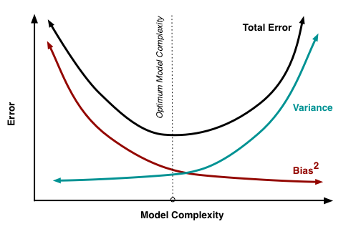
Bias—Variance Compromise
Fortmann-Roe, 2012

Slide 7
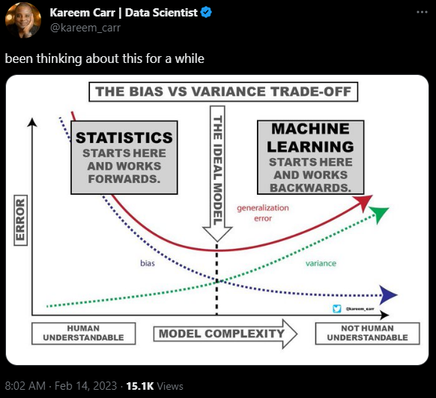
Bias—Variance Compromise

Slide 8
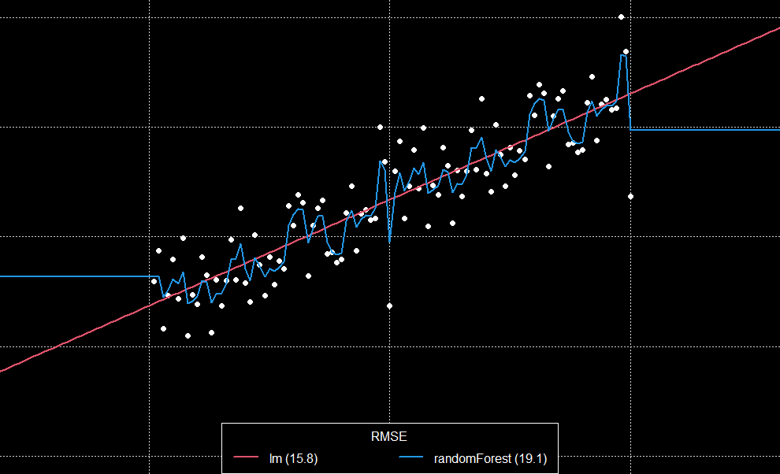
Bias—Variance Compromise
Notes:
TODO: demonstrate adjusting nodesize argument to randomForest()

Slide 9
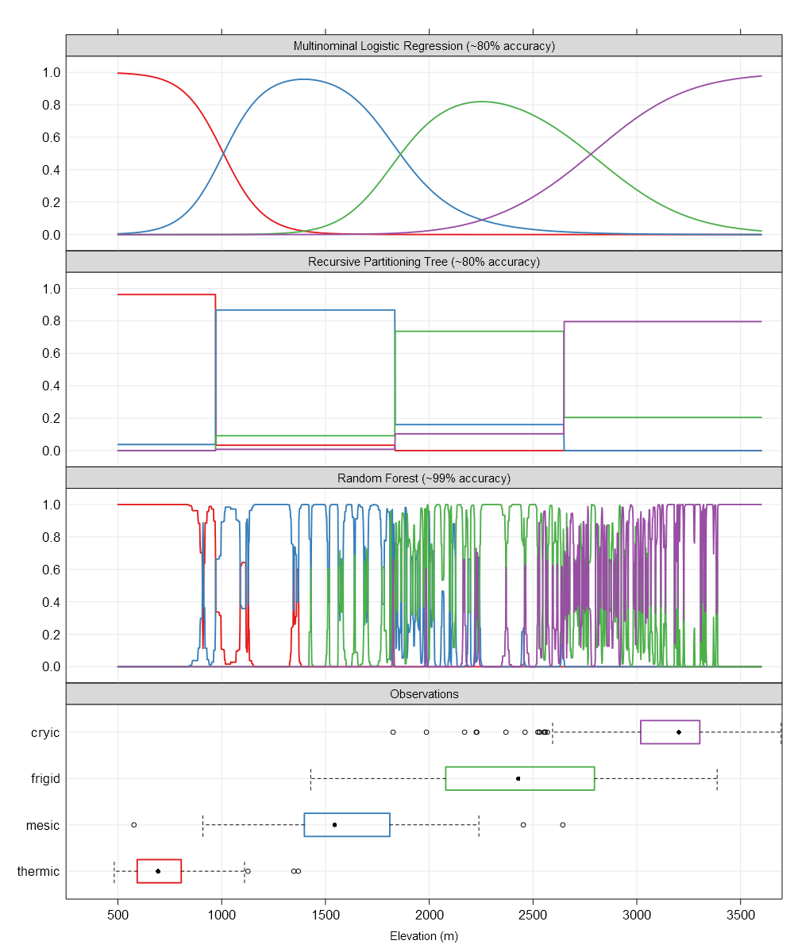
Bias—Variance Compromise
Notes:
The top panel represents the smooth surface fit by multinomial logistic regression. These smooth surfaces lend to testable interpretations such as “the transition between STR per 1,000’ of elevation gain follows XXX”. This is far more useful when the model includes other factors such as annual beam radiance and the effect of cold air drainages. Absolute accuracy is sacrificed for a general (e.g. continuous over predictors) representation of the system that can support inference. Another example, “at elevation XXX, what is the average effect of moving from a south-facing slope to a north-facing slope?”.
The second panel down represents the hard thresholds generated by an algorithm from the tree-based classification framework (e.g. recursive partitioning trees via rpart). Accuracy is about the same as the MLR approach and the hard breaks can be interpreted as “reasonable” cut points or thresholds that may have links to physical processes. Note that the cut points identified by this framework are very close to the 50% probability cross-over points in the MLR panel. The result is a (potentially) pragmatic partitioning of reality that can support decisions but not inference (e.g. “rate of change in Pr(STR) vs. 1000’ elevation gain”).
The third panel down represents the nearly-exact (over?) fitting of STR probabilities generated by the random forest framework. This approach builds thousands of classification trees and (roughly) averages them together. The results are incredible (unbelievable?) within-training-set accuracy (99% here) at the expense of an interpretable model. That isn’t always a problem: sometimes predictions are all that we have time for. That said, this framework requires a 100x larger training sample (vs. MLR) and an independent validation data set before it can be trusted on new data.

Slide 10
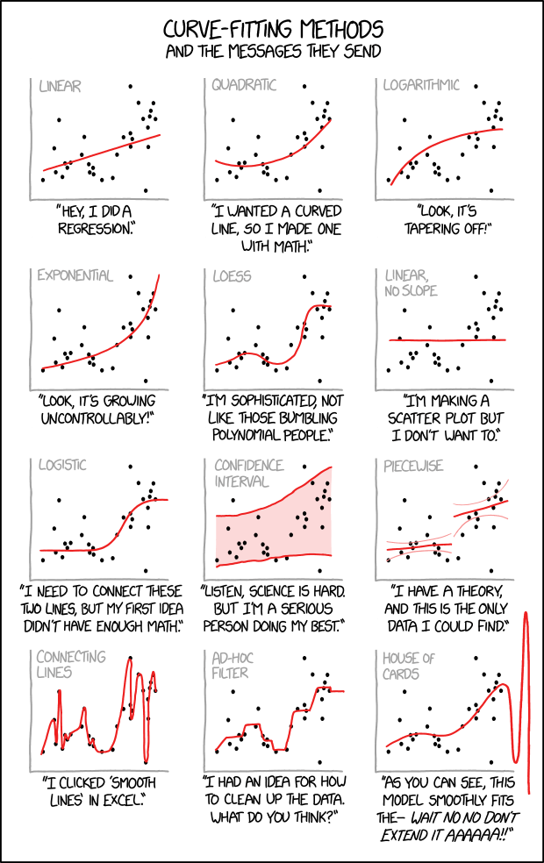
Bias—Variance Compromise
https://xkcd.com/2048/

Slide 11
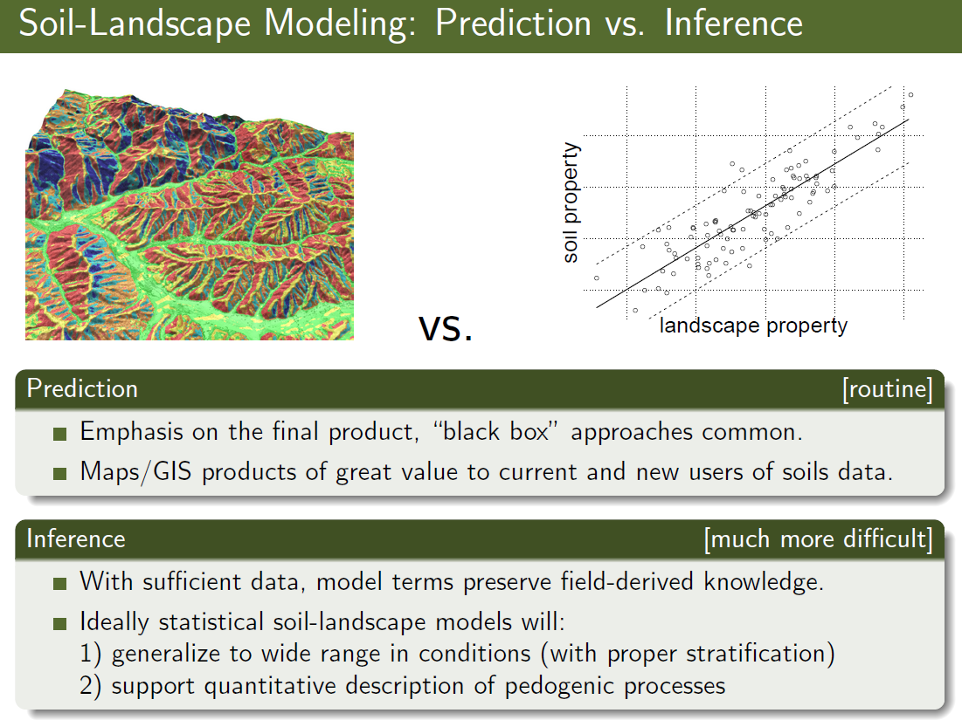
Prediction vs. Inference

Slide 12
Types of Validation (quantifying error)
Apparent Validation
goodness of fit
analysis of residuals:
Heteroscedasticity (homogeneity of variance)?
non-normality
lack of independence
Internal Validation
Split-sample: fit using training subset, evaluate with validation subset
Cross-validation: alternating development / validation subsets
Bootstrap: iterative random sub-sampling with replacement
External Validation
fresh data
Increasingly complex models require more comprehensive validation strategies
Notes:
Three internal validation techniques are shown. Split-sample means that a random split is made, resulting in e.g. a 50% development and a 50% validation sample. Cross-validation uses the same principle, but alternates the development and validation samples (e.g. 50:50 split means 2 development and test rounds; a 90:10 split 10 rounds). The most extreme variant of cross-validation is the ‘jack-knife’, where n-1 patients are used for model development, with validation on the patient who was left out. The bootstrap is however the preferred technique (see next slide).

Slide 13
Apparent Validation
ols(MAST ~ seki_abr + seki_tci + rcs(seki_elev, 3),
data = g, weights = weight)
Model Likelihood Discrimination
Ratio Test Indexes
Obs 438 LR chi2 1265.63 R2 0.944
sigma .8428 d.f. 4 R2 adj 0.944
d.f. 433 Pr(> chi2) 0.0000 g 3.519
lrm(formula = STR ~ seki_elev + seki_abr + seki_tci, data = g,
x = TRUE, y = TRUE, weights = weight)
Model Likelihood Discrimination Rank Discrim.
Ratio Test Indexes Indexes
Obs 438 LR chi2 633.74 R2 0.812 C 0.951
Sum of weights486 d.f. 3 g 4.782 Dxy 0.903
max |deriv| 3e-05 Pr(> chi2) <0.0001 gr 119.382 gamma 0.905
gp 0.430 tau-a 0.592
Brier 0.043

Slide 14
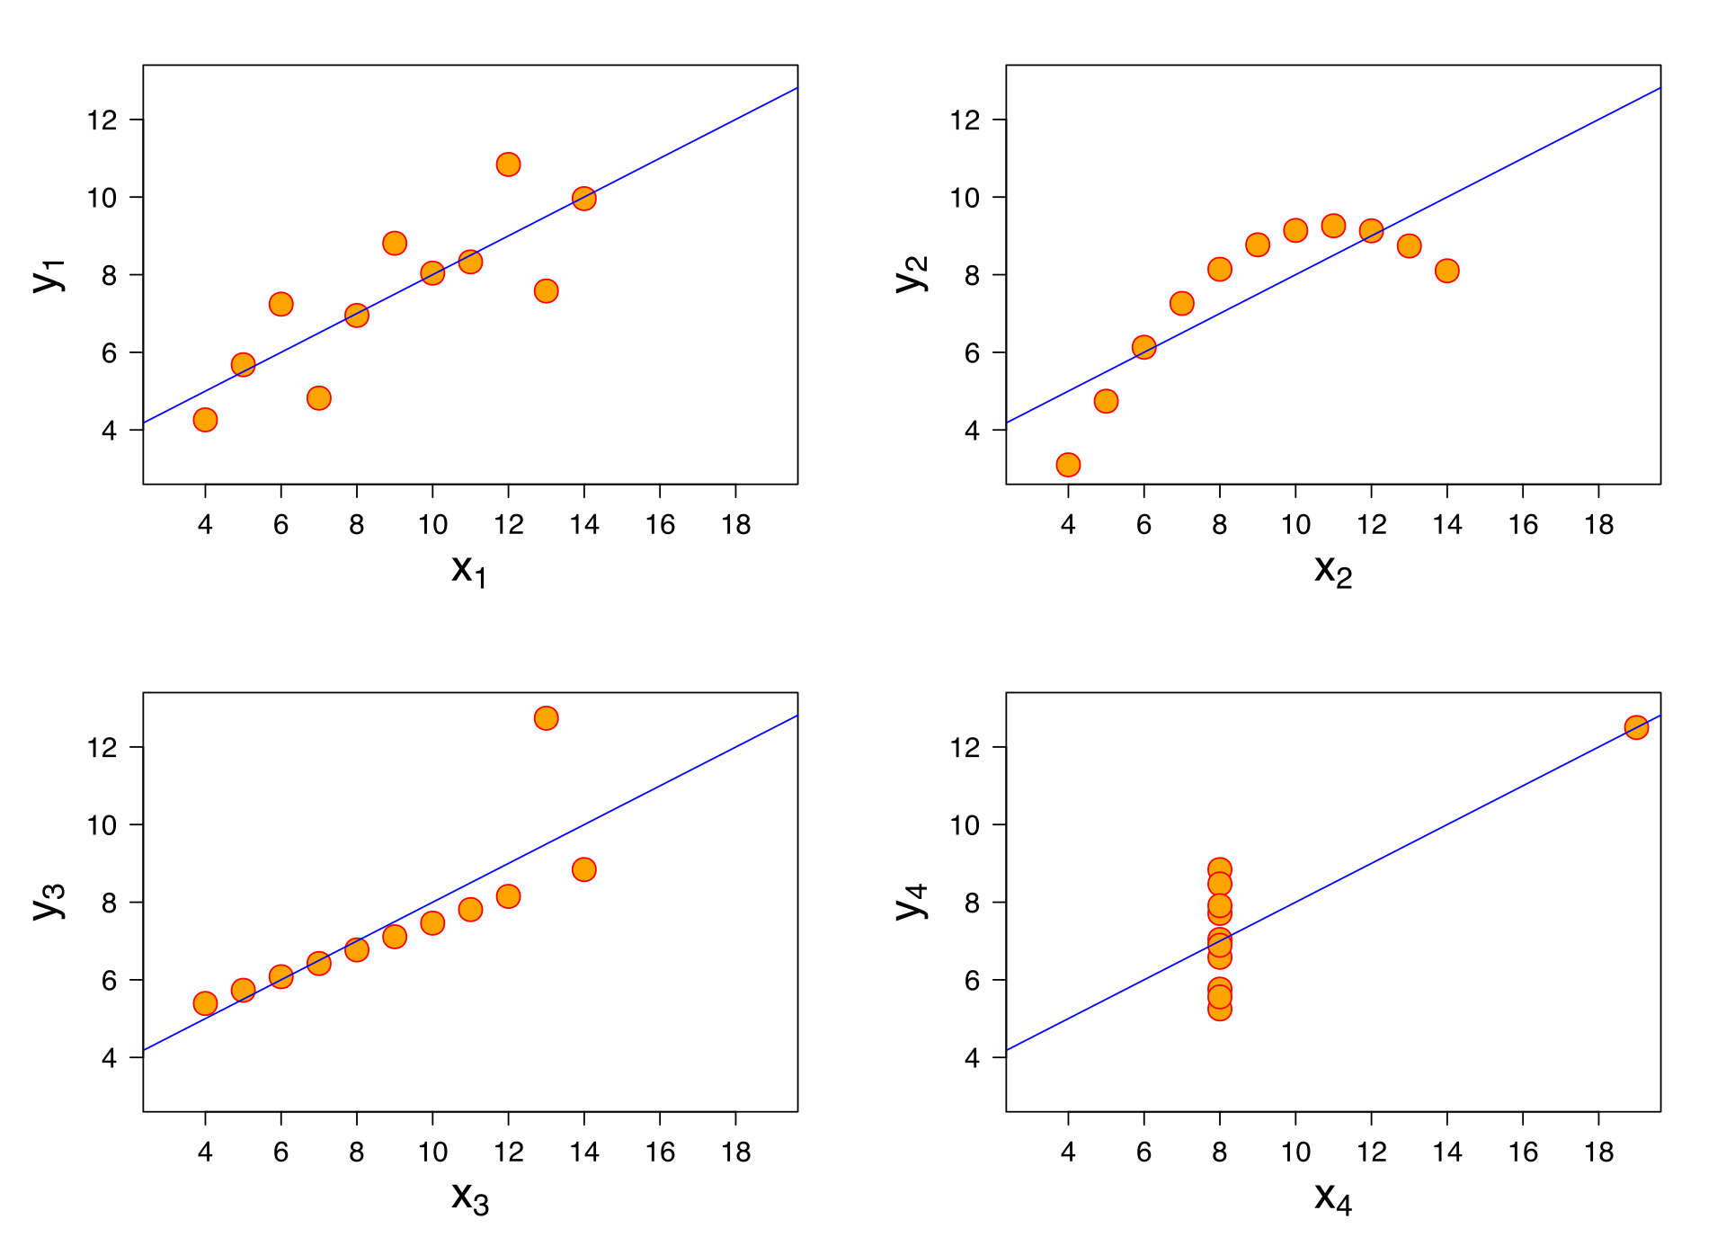
Apparent Validation
be careful with apparent validation: these all share the same $R^{2}$ !

Slide 15
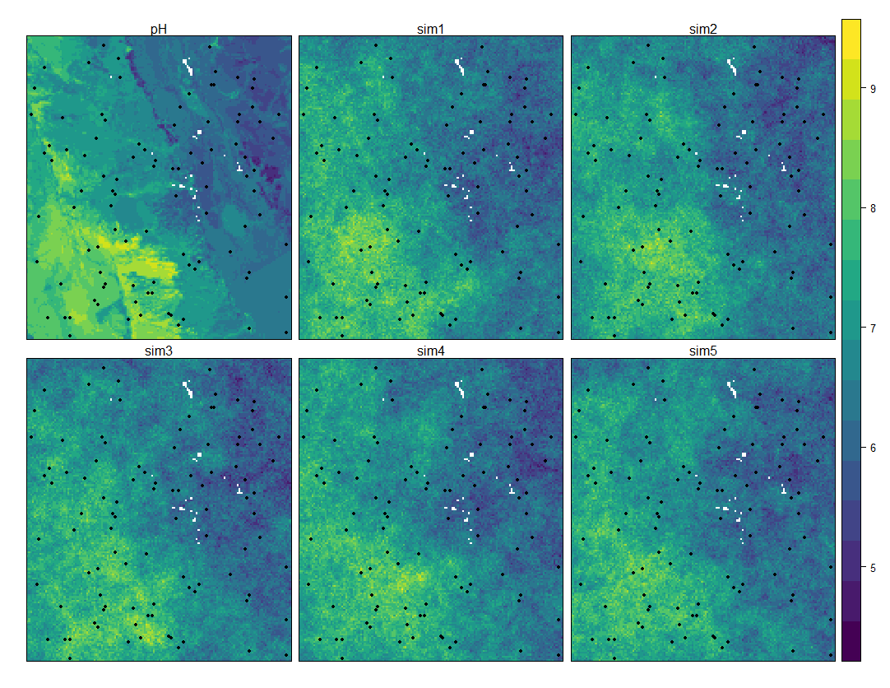
Apparent Validation
be careful with apparent validation: these all share the same $RMSE$ !

Slide 16
Internal Validation
K=3
Test
Train
Test Test
Train
Test
Train
Train
"k-fold" cross-validation:
all the samples in the dataset are eventually used for both training and testing
averages error across all folds to determine x-validation error
choice of K, is a classic problem of bias-variance trade-off
this is not a replacement for an independent validation!

Slide 17
Internal Validation
Test
Train
bootstrap:
random sampling with replacement, aka Monte-Carlo sampling
essentially a simulation over all (many) possible combinations
large number of iterations (100-1,000) required, time-consuming
this is not a replacement for an independent validation!

Slide 18
Validation Metrics
Ratio (continuous)
RMSE
MAE
correlation coefficient
mean "distance" (n-D) from standard
Nominal (categorical, without order)
probability-based:
Brier score
confusion matrix-based:
% correctly classified
kappa
weighted tau

Slide 19
Uncertainty Metrics
Ratio (continuous)
standard error of estimates (SE)
prediction intervals (percentiles)
distance / contrast (e.g. soil color)
Nominal (categorical, without order)
Shannon entropy
confusion index

Slide 20
Uncertainty: Model Parameters
Linear Regression Model
ols(formula = MAST ~ seki_abr + seki_tci + rcs(seki_elev, 3),
data = g, weights = weight, x = TRUE, y = TRUE)
Model Likelihood Discrimination
Ratio Test Indexes
Obs 438 LR chi2 1265.63 R2 0.944
sigma0.8428 d.f. 4 R2 adj 0.944
d.f. 433 Pr(> chi2) 0.0000 g 3.519
Residuals
Min 1Q Median 3Q Max
-2.0637 -0.4328 -0.1113 0.1300 4.0204
Coef S.E. t Pr(>|t|)
Intercept 15.5143 0.3832 40.49 <0.0001
seki_abr 0.0001 0.0000 18.90 <0.0001
seki_tci -0.0621 0.0142 -4.38 <0.0001
seki_elev -0.0057 0.0001 -46.14 <0.0001
seki_elev' 0.0017 0.0002 9.09 <0.0001

Slide 21
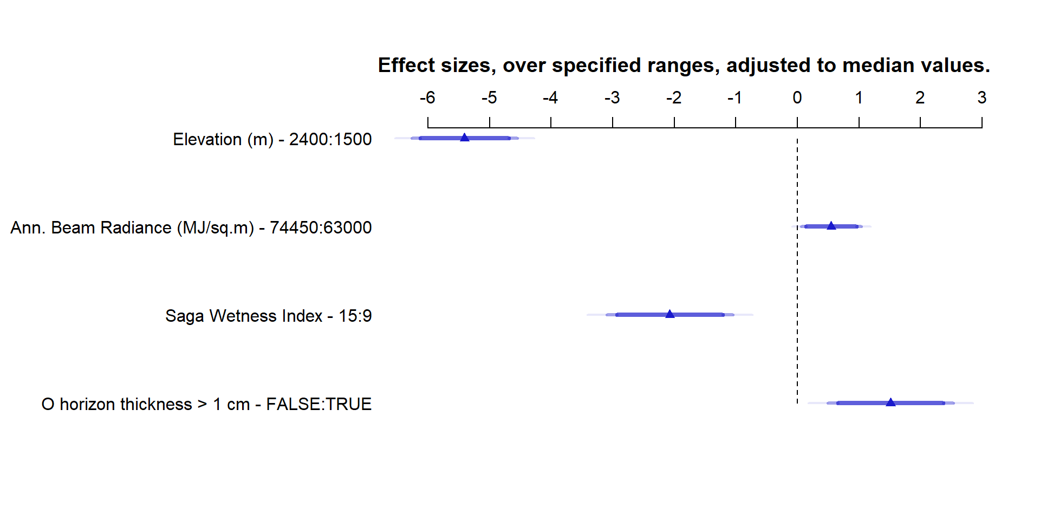
Uncertainty: Model Parameters
MAST model for Yosemite National Park

Slide 22
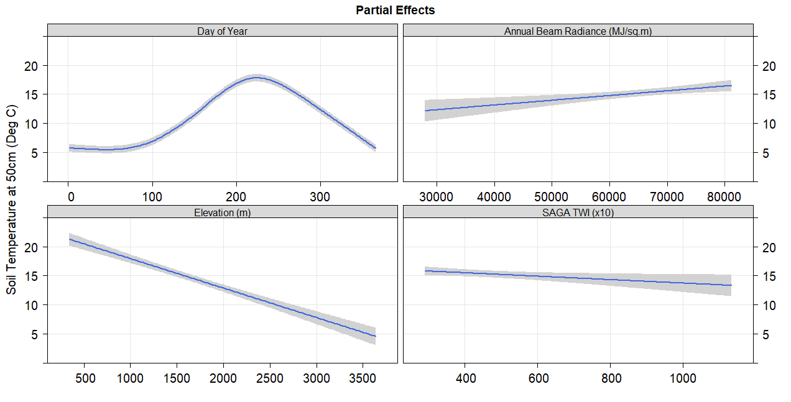
Uncertainty: Model Parameters
“summer”
“hot slopes”
“winter”
“cool slopes”
“summits/shoulders”
“foothills”
“mountains”
“alpine”
“cold air drainages”
Daily soil temperature model from Sequoia Kings Canyon

Slide 23
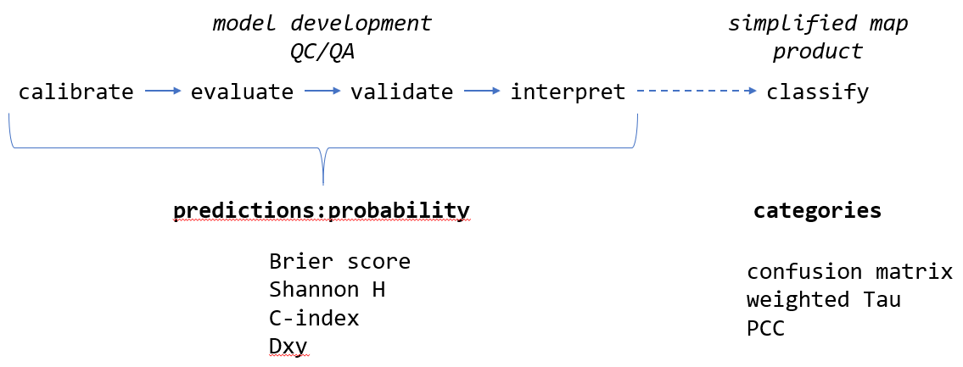
Accuracy / Uncertainty: Concepts (classes)
most future applications of statistical modeling (DSM) will be class-based

Slide 24
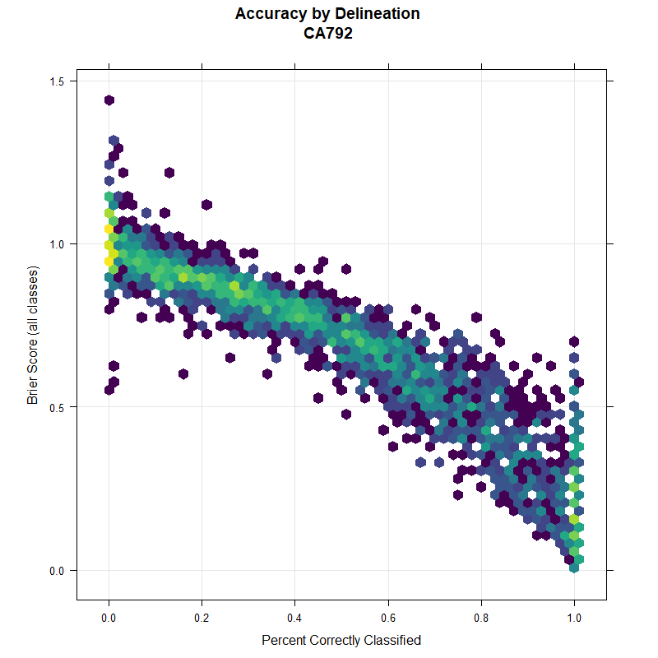
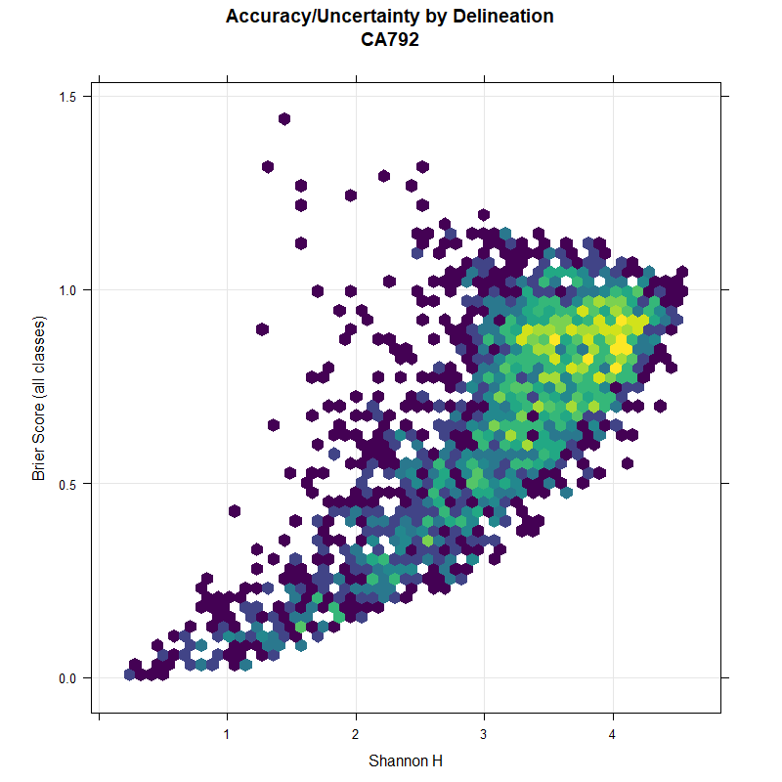
Accuracy / Uncertainty: Concepts (classes)
Results from Sequoia-Kings Canyon (CA792) DSM study.
Notes:
related, but not the same

Slide 25
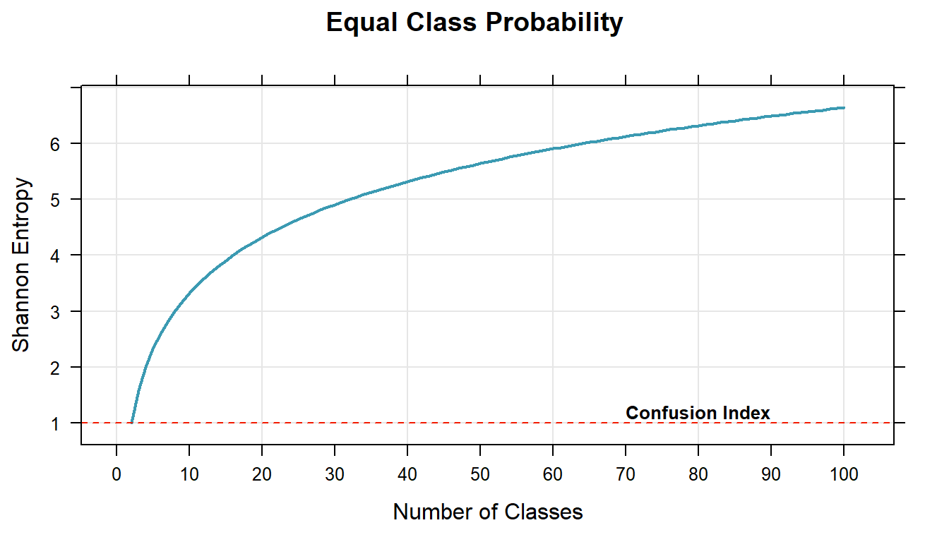

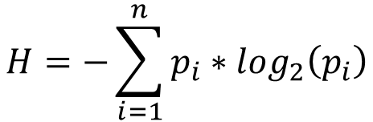
Uncertainty / Information / Confusion
$$H=−\sum_{i=1}^{n}{p_{i}∗\log_{2}\left(p_{i}\right)}$$
$$CI= \left[1−\left(p_{max}−p_{max−1}\right)\right]$$

Slide 26
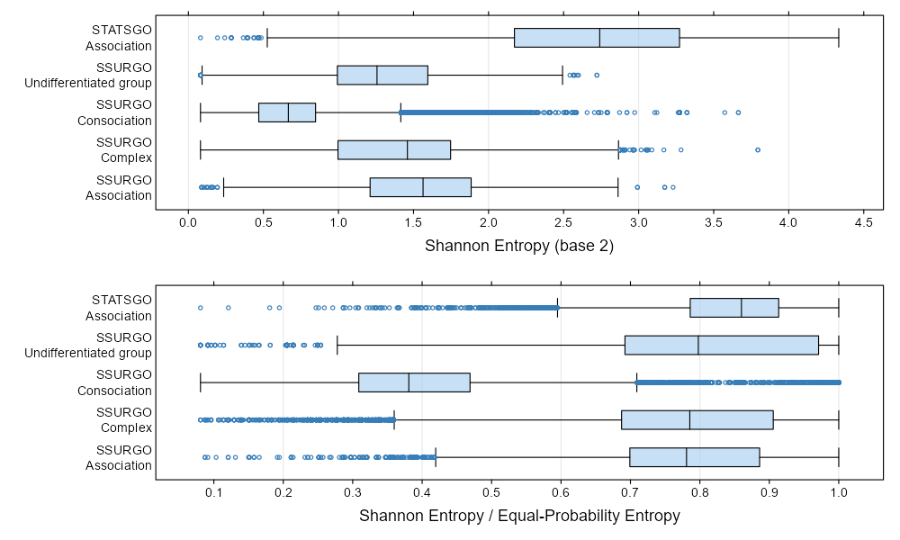
Uncertainty / Information / Confusion
$$H=−\sum_{i=1}^{n}{p_{i}∗\log_{2}\left(p_{i}\right)}$$
$$CI= \left[1−\left(p_{max}−p_{max−1}\right)\right]$$

Slide 27
5 Minute Break

Slide 28
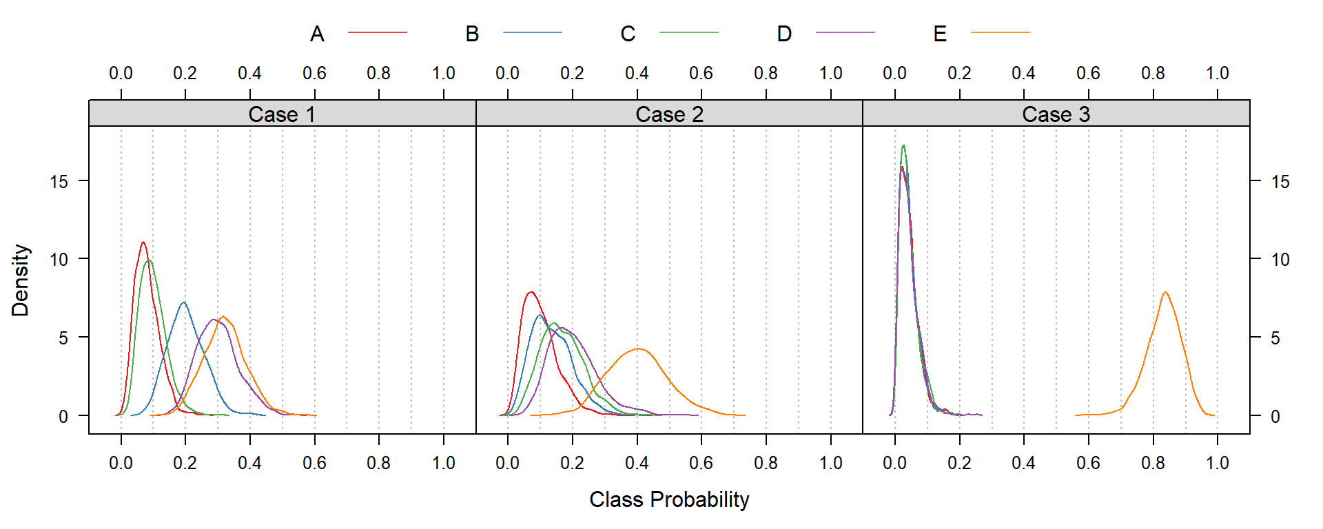
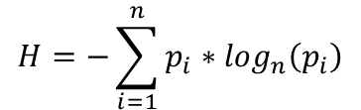
Uncertainty / Information / Confusion
$$H=−\sum_{i=1}^{n}{p_{i}∗\log_{n}\left(p_{i}\right)}$$
"Case 1": classes D and E are nearly tied for the most likely class, but their respective probabilities are generally < 0.5
"Case 2": class E is almost always the most likely class, but classes B, C, and D are tied for second place
"Case 3": class E is always the most likely class; all other classes have probabilities < 0.2

Slide 29
Uncertainty / Information / Confusion
$$H=−\sum_{i=1}^{n}{p_{i}∗\log_{n}\left(p_{i}\right)}$$
"Case 1": predictions for soil classes represent a hillslope complex that isn't quite disentangled by the model
"Case 2": predictions for soil classes represent limited success in partitioning between a single water shedding (E) vs. multiple water collecting positions (A-D)
"Case 3": predictions for soil classes represent a successful partitioning between Holocene age deposits (E) vs. older alluvial terraces (A-D)

Slide 30
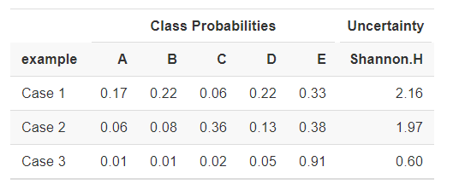
Uncertainty / Information / Confusion
$$H=−\sum_{i=1}^{n}{p_{i}∗\log_{n}\left(p_{i}\right)}$$

Slide 31
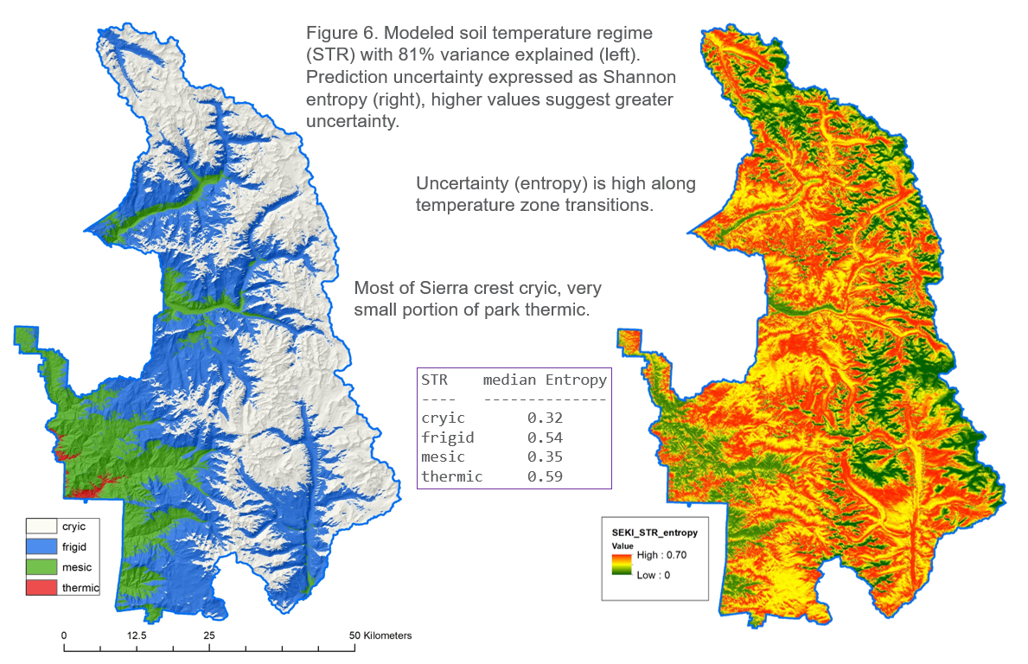
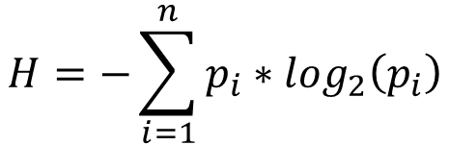
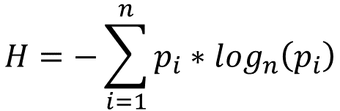
Uncertainty / Information / Confusion
$$H=−\sum_{i=1}^{n}{p_{i}∗\log_{n}\left(p_{i}\right)}$$
$$H=−\sum_{i=1}^{n}{p_{i}∗\log_{2}\left(p_{i}\right)}$$
$$CI= \left[1−\left(p_{max}−p_{max−1}\right)\right]$$
Notes:
using normalized Shannon entropy

Slide 32
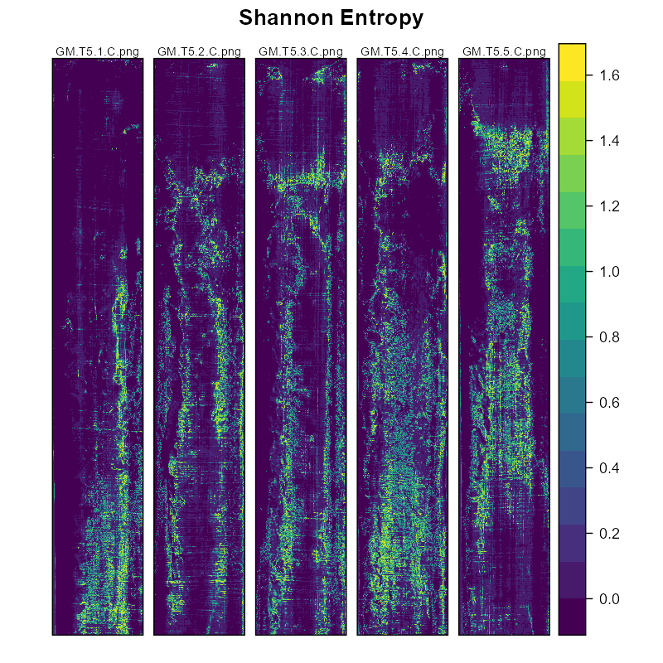
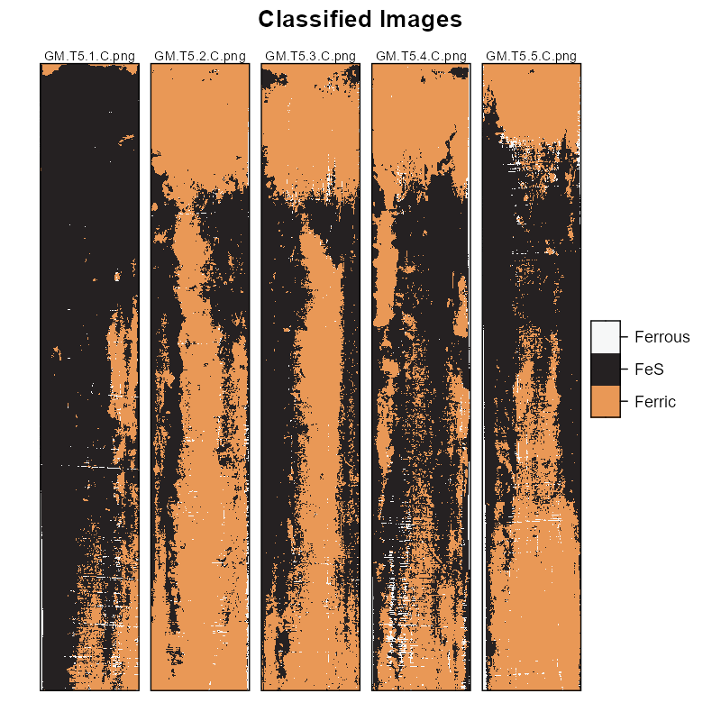
Uncertainty / Information / Confusion
$$H=−\sum_{i=1}^{n}{p_{i}∗\log_{2}\left(p_{i}\right)}$$
$$CI= \left[1−\left(p_{max}−p_{max−1}\right)\right]$$
Duball, C.E., D. Beaudette, A. Puchkoff, and K. Vaughan.
Quantified analysis of Indicator of Reduction in Soil films.
Soil Sci. Am. J. In progress.

Slide 33
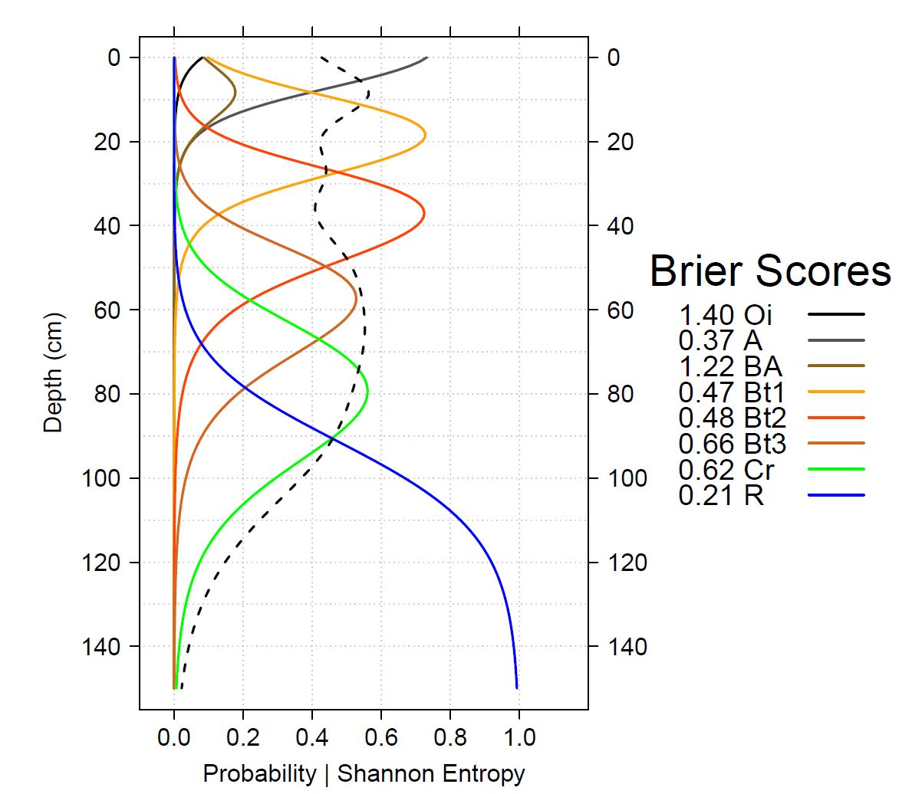

Uncertainty / Information / Confusion
$$H=−\sum_{i=1}^{n}{p_{i}∗\log_{n}\left(p_{i}\right)}$$
$$H=−\sum_{i=1}^{n}{p_{i}∗\log_{2}\left(p_{i}\right)}$$
$$CI= \left[1−\left(p_{max}−p_{max−1}\right)\right]$$
Notes:
DSMorph Book chapter 18

Slide 34
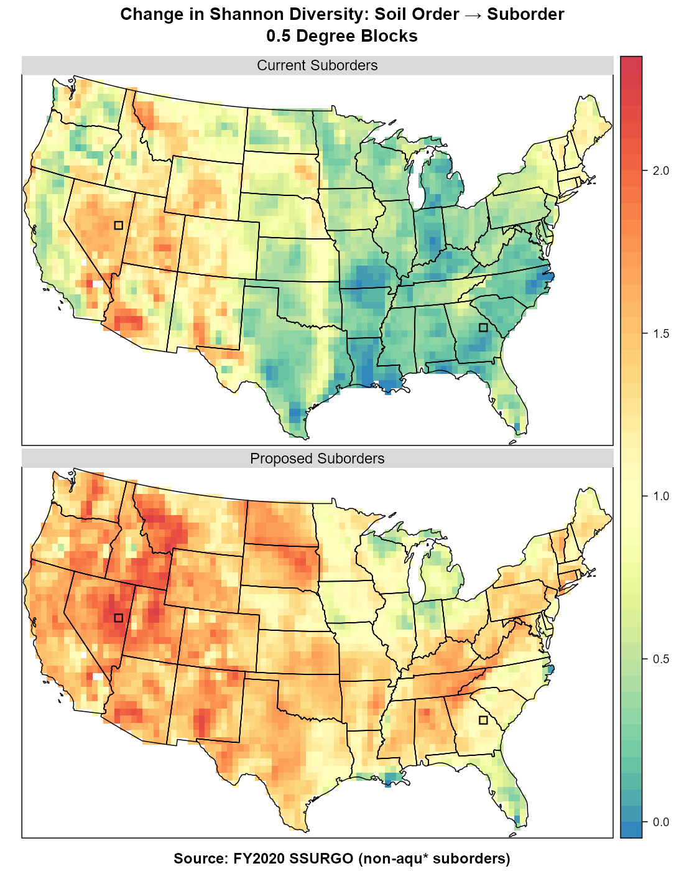
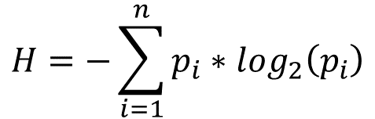
Uncertainty / Information / Confusion
$$H=−\sum_{i=1}^{n}{p_{i}∗\log_{2}\left(p_{i}\right)}$$
$$H=−\sum_{i=1}^{n}{p_{i}∗\log_{2}\left(p_{i}\right)}$$
$$CI= \left[1−\left(p_{max}−p_{max−1}\right)\right]$$
Stolt, MH, O'Geen, AT, Beaudette, DE, et al. Changing the hierarchical placement of soil moisture regimes in Soil Taxonomy. Soil Sci Soc Am J. 2021;1−13. https://doi.org/10.1002/saj2.20219
Notes:
https://acsess.onlinelibrary.wiley.com/doi/10.1002/saj2.20219

Slide 35
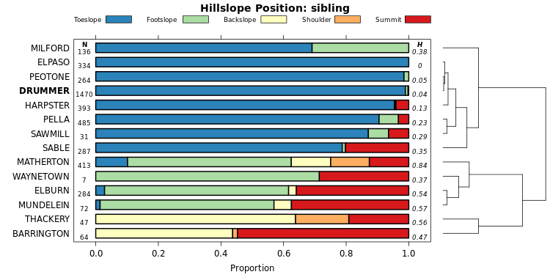
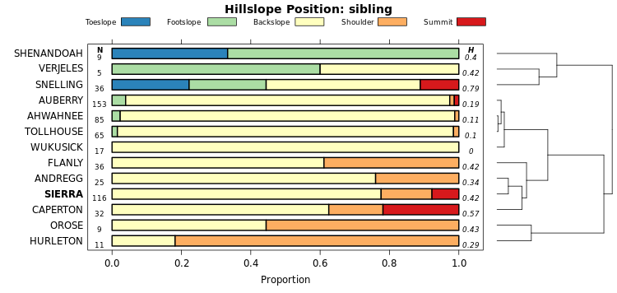
Uncertainty / Information / Confusion
$$H=−\sum_{i=1}^{n}{p_{i}∗\log_{2}\left(p_{i}\right)}$$
$$CI= \left[1−\left(p_{max}−p_{max−1}\right)\right]$$

Slide 36
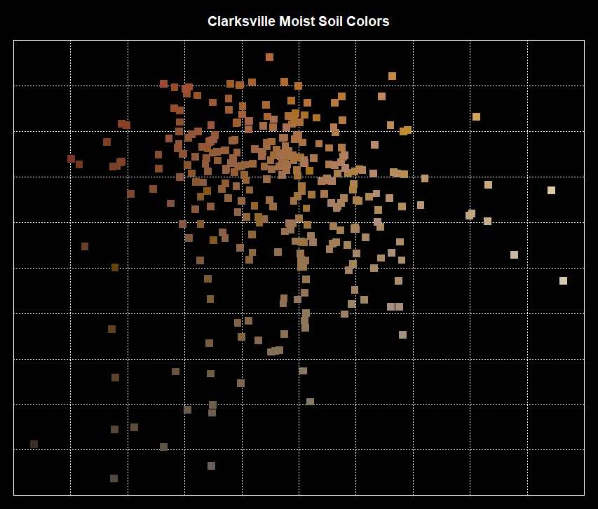
The Future: Wrangling Variability / Uncertainty

Slide 37
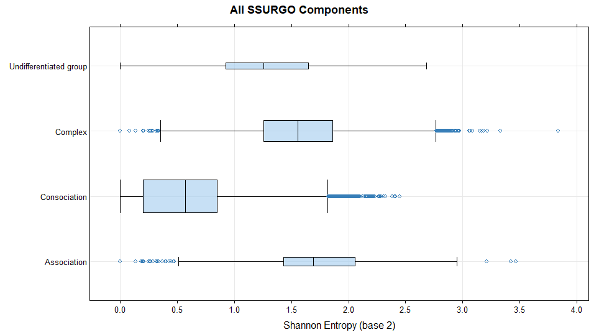
Live Coding / Assignment
https://github.com/ncss-tech/stats_for_soil_survey/blob/master/exercises/mukind-entropy-1.R
https://github.com/ncss-tech/stats_for_soil_survey/blob/master/exercises/mukind-entropy-2.R
https://github.com/ncss-tech/stats_for_soil_survey/blob/master/exercises/CA792-MAST-STR-modeling.R

Slide 38
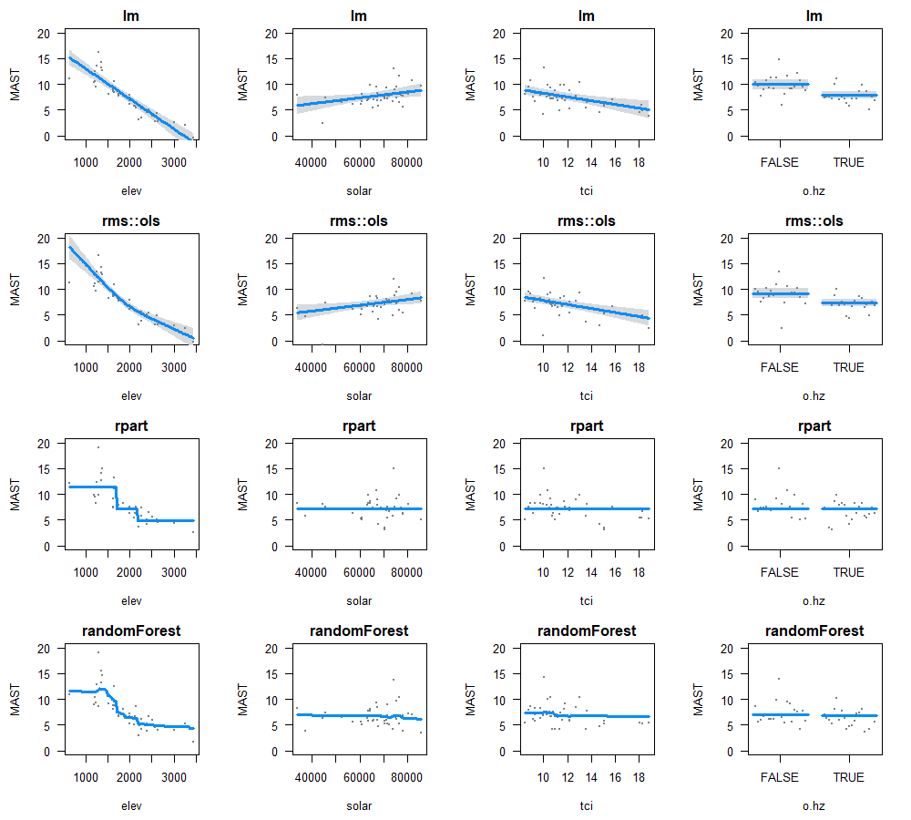
Bias—Variance Compromise

